Slide 1
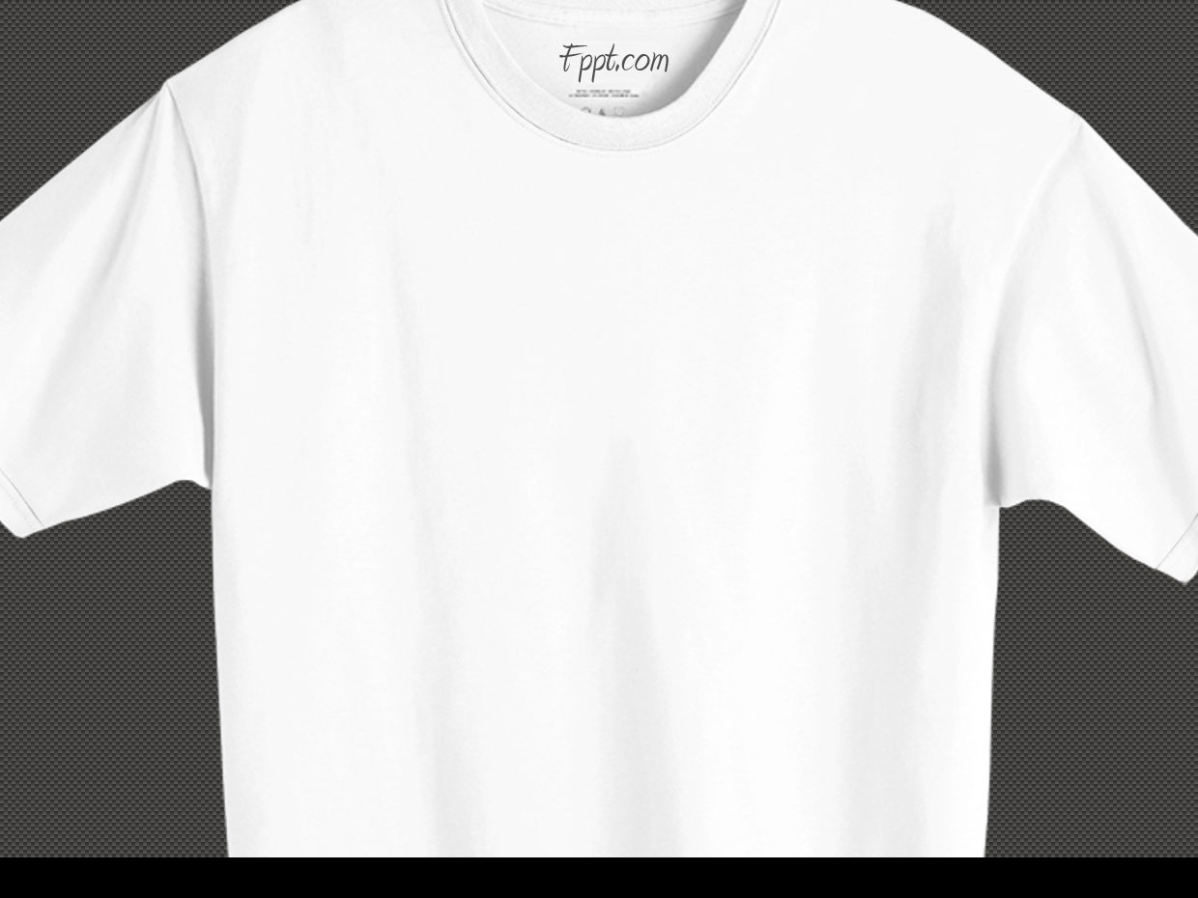
Online Fitting Room
Group members:Mohamed Ayman ,Mohamed Abdelaziz,Mohamed Osama, Tarek Medhat
SupervisedBy:Prof.Khaled Hussien
Eng.Hager Sobeah,Eng.Maha Sayed

Slide 2
OUTLINE

Slide 3
Introduction

Slide 4


Slide 5
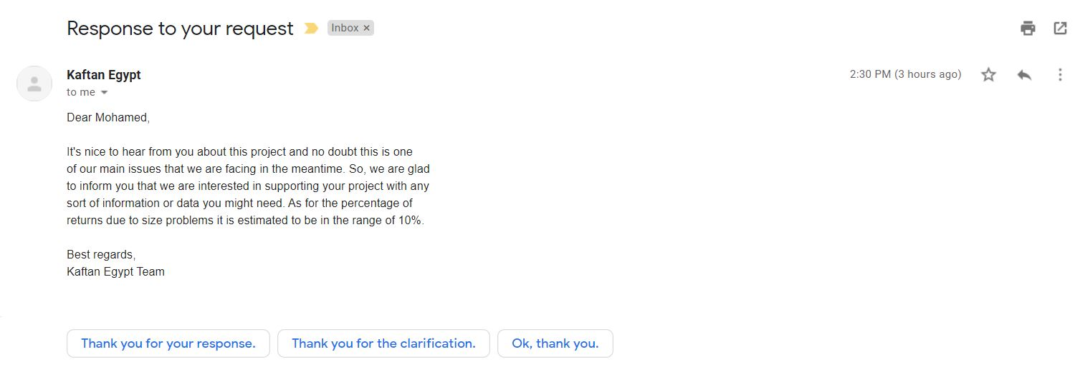
Supportive Document

Slide 6
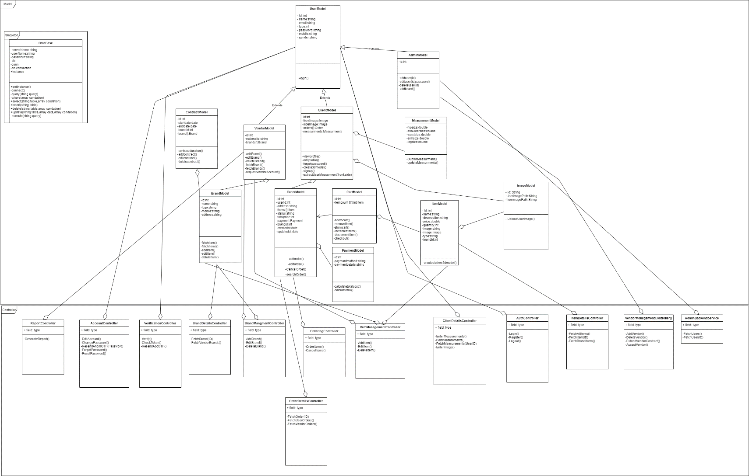
Class Diagram

Slide 7
Use Case Diagram

Slide 8
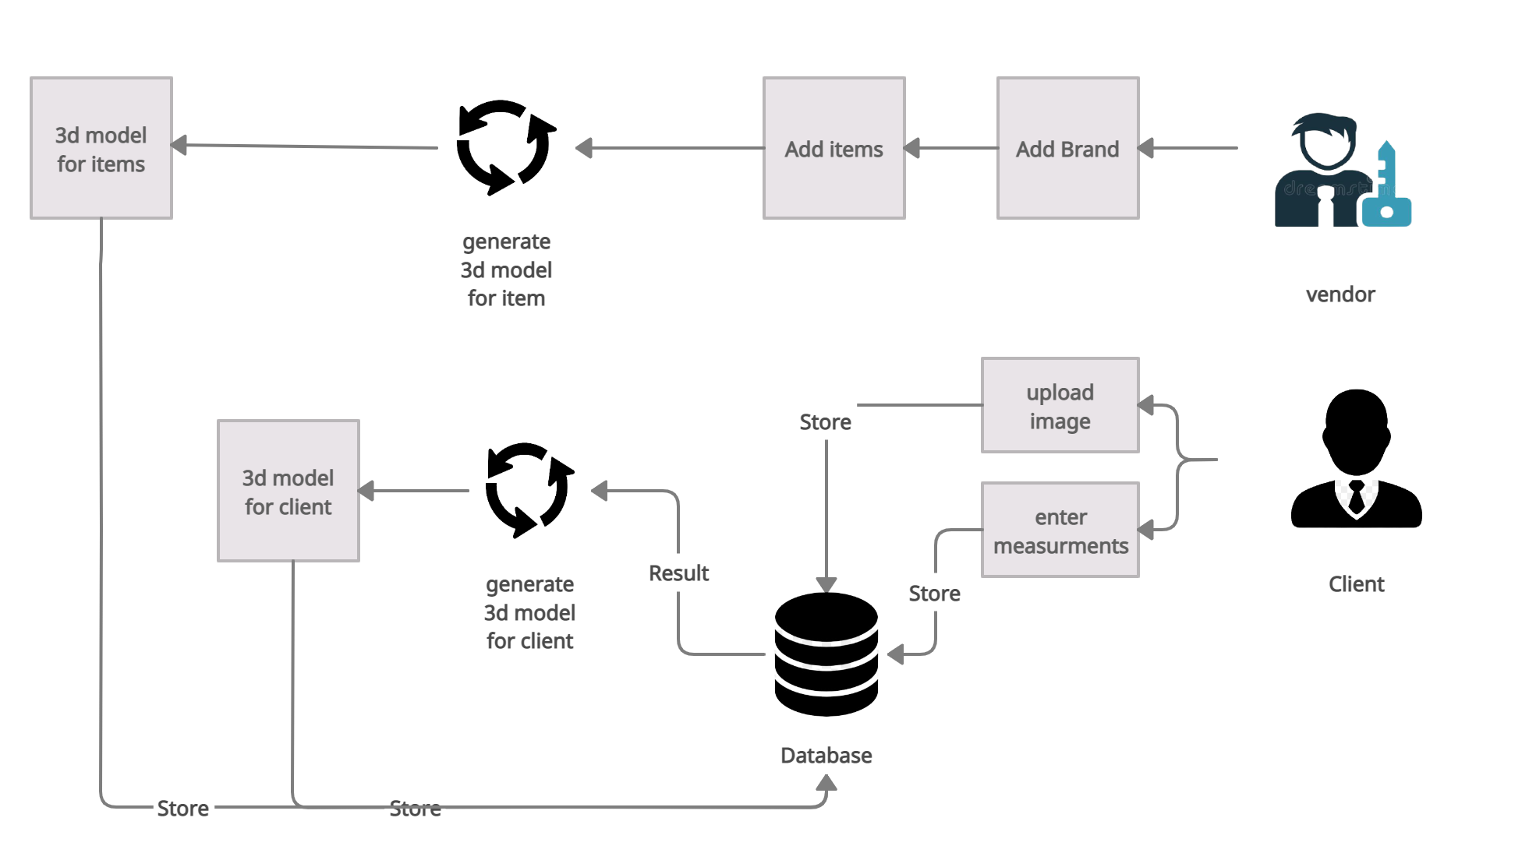
Business Diagram

Slide 9
Similar System(1/2)

Slide 10
Similar System(2/2)

Slide 11
Comparison of creating 3d model
Our 3d model | Anthropometric clothing measurements from 3D body scans
we use tensorflow to train dataset that derived from the CAESAR dataset which consist of 1531 female meshes and 1517 male meshes. The resolution of each mesh is 12500 vertices and 25000 facets.

Slide 12
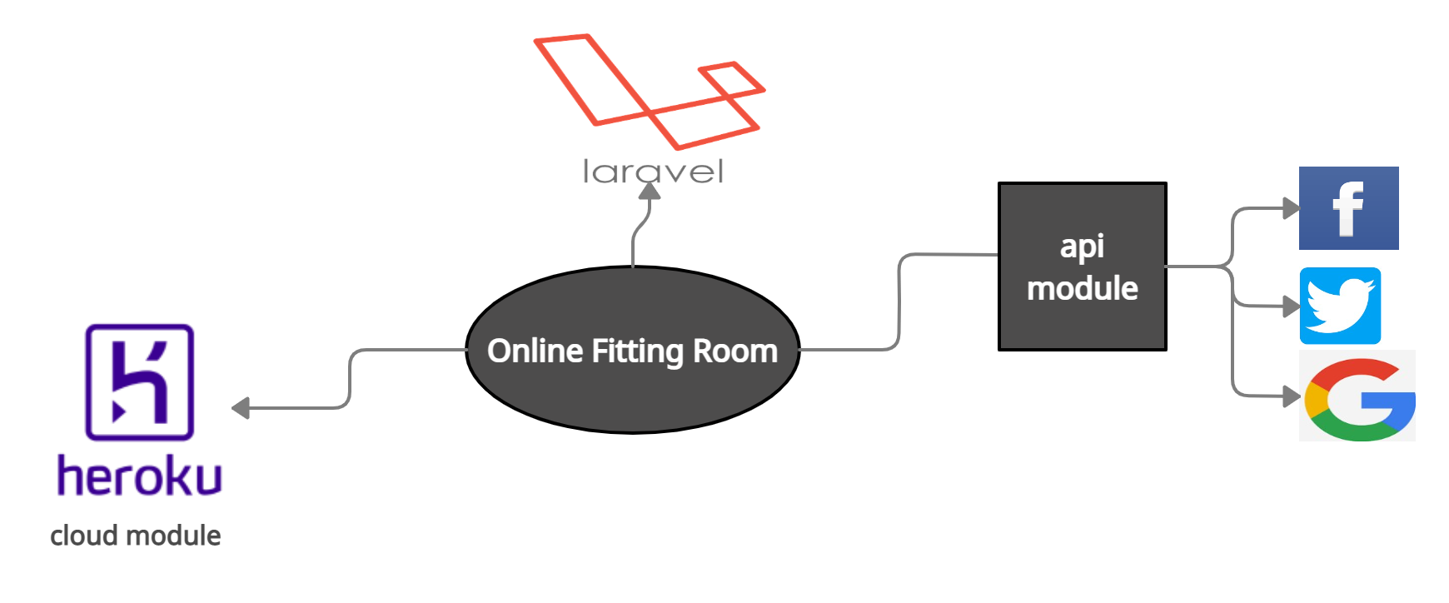
Block Diagram

Slide 13
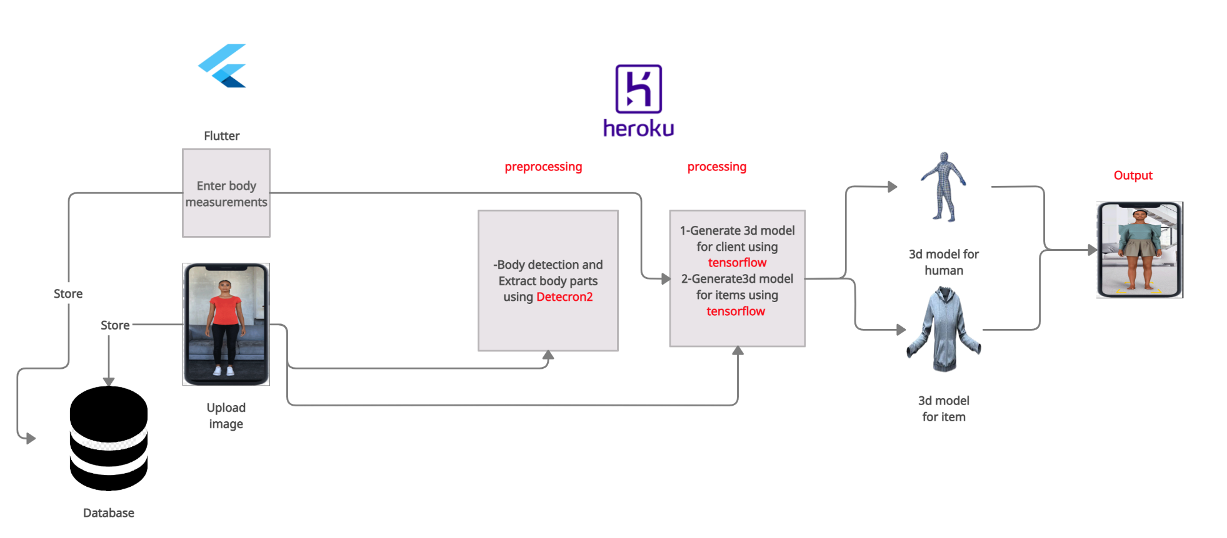
System Overview

Slide 14
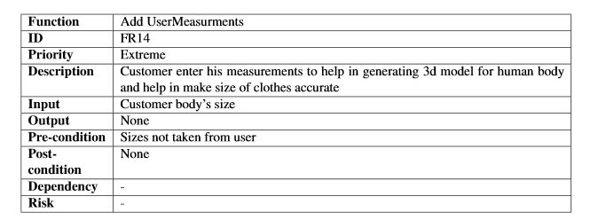
Function requirements(1/4)

Slide 15
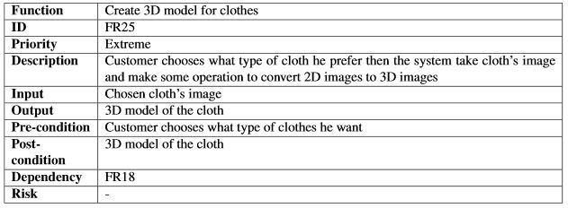
Function requirements(2/4)

Slide 16
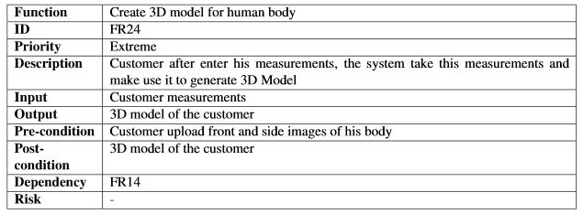
Function requirements(3/4)

Slide 17
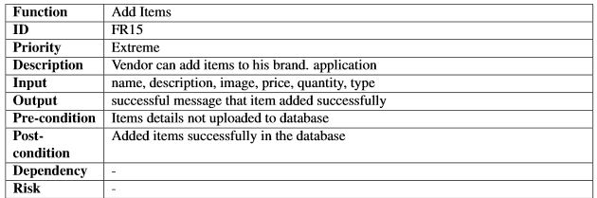
Function requirements(4/4)

Slide 18
Non-Functional requirements

Slide 19
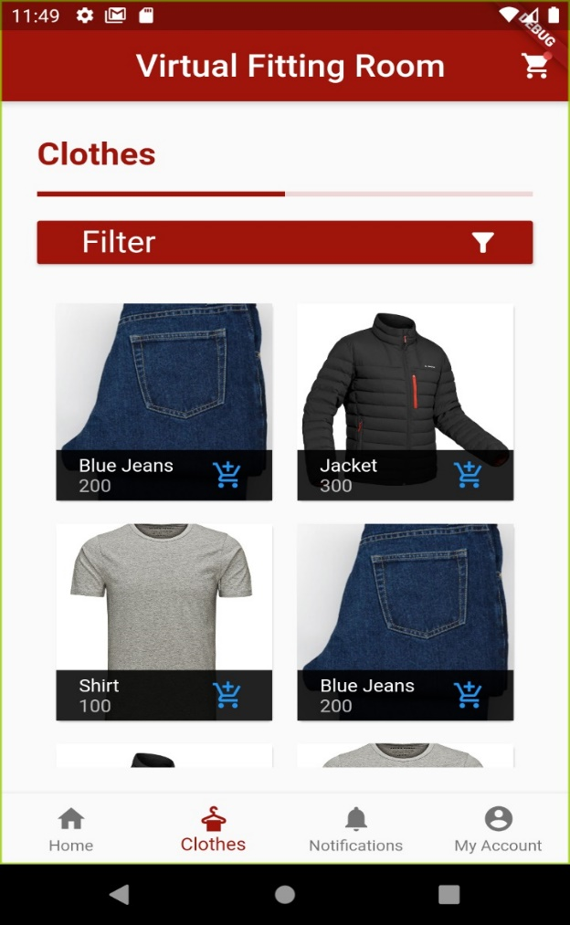
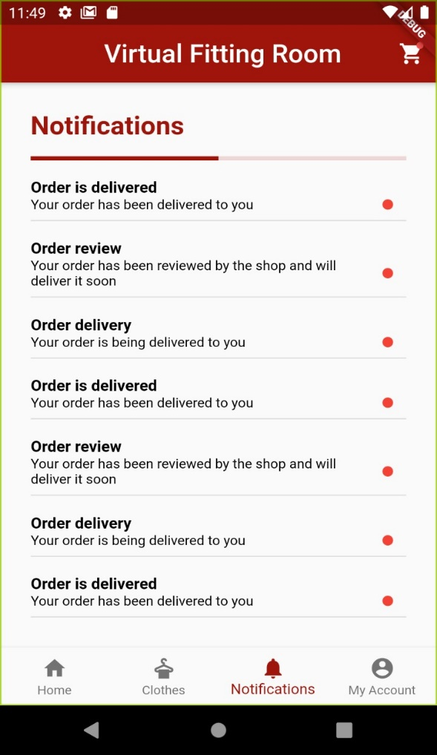
GUI(1/2)
Items page
Notification page

Slide 20
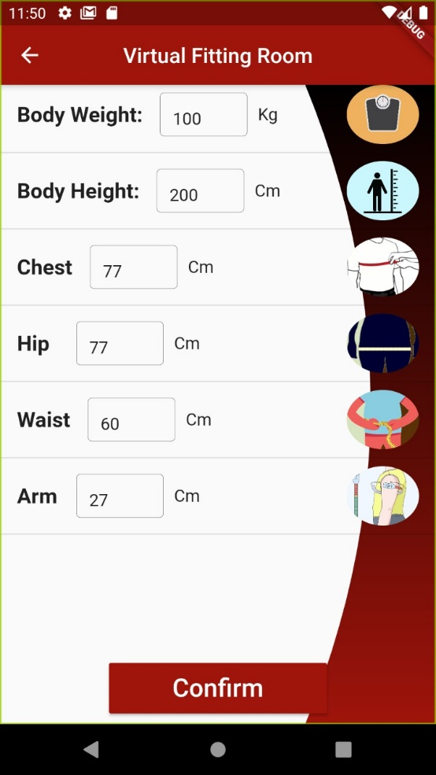
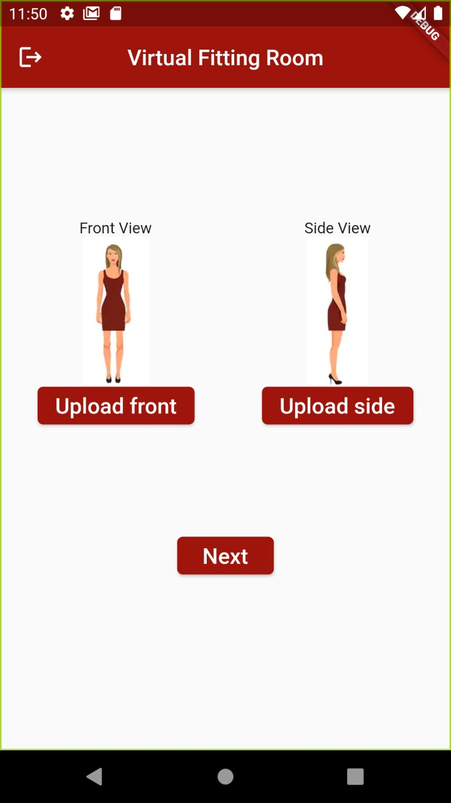
GUI(2/2)
Client measurements page

Slide 21
Demo

